Slide 1
MOBILE CLOUD COMPUTING
Green Seamless Service Provisioning with Mobile Cloud Computing
Assigned by- Ms. Nashrah Gowalkar

Slide 2
TEAM 5
021
AMEY KESARKAR
037
DHRITI PATEL
038
ASITA PATHAK
044
AYUSH RANE
054
CHAITANYA SHIRKE
066
SHRUTI GHOSH

Slide 3
Architecture of Mobile Ad Hoc Cloud
Formation of Mobile Ad Hoc Cloud
Functioning of Mobile Ad Hoc Cloud
Issues and Challeneges of Mobile Ad Hoc Cloud

Slide 4
Introduction
MCC reduces the energy consumption of mobile devices.
Major problem of limited WAN latency.
Seamless service provisioning method with ad hoc mobile cloud is proposed by Ravi and Peddoju .
Mobile ad hoc cloud based on MANET (mobile ad hoc network).
Here, cloud and mobile ad hoc cloud are used for offloading.
The application will be executed in mobile ad hoc cloud itself.
Needless communication between the mobile device and cloud is minimized.
Energy consumption is reduced

Slide 5
Architecture of Mobile Ad Hoc Cloud
1

Slide 6
1
The architecture of mobile ad hoc cloud is presented by Rahman et al. and Mukherjee et al.
Takes the service from both the mobile ad hoc cloud and the default cloud in the architecture.
The minimax algorithm proceeds all the way down to the terminal node of the tree, then backtrack the tree as the recursion.
2
3

Slide 7
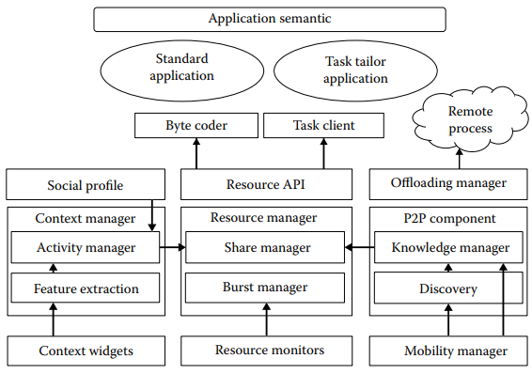

Slide 8
Formation of Mobile Ad Hoc Cloud
2

Slide 9
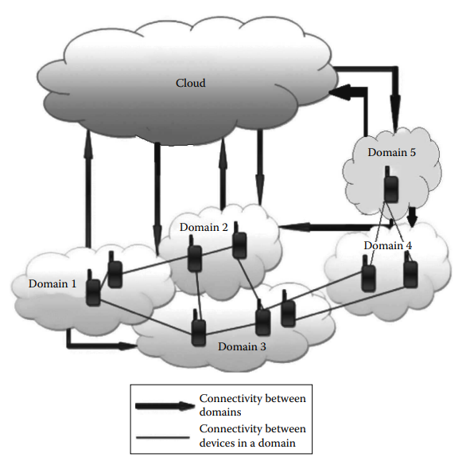
The number of mobile devices that forms a domain depends on the capacity of the wireless network connecting the device to the domain.

Slide 10
Functioning of Mobile Ad Hoc Cloud
3

Slide 11
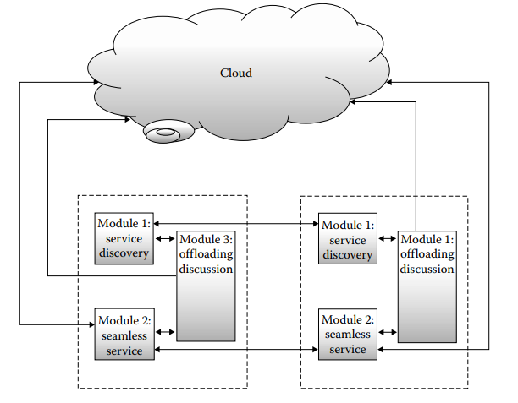
Framework has 3 functions
Service Discovery
Seamless service
Offloading Descision

Slide 12

Module 1
Service Discovery
A device in a domain can know about the availability of the service in another domain.
When a device enters a mobile ad hoc cloud, the discovery message is advertised.
The message is received by all other devices, and they update their service discovery table.
The Structure of Discovery Table

Slide 13
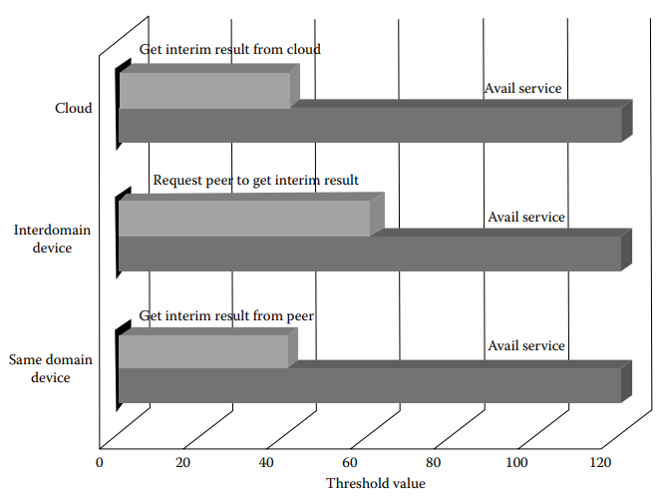
Module 2
Seamless Service
To provide seamless service, it is required to keep track of the signal strength of devices in a mobile ad hoc cloud.
The received signal strength indication (RSSI) is a measure to do so, and a threshold RSSI is maintained.

Slide 14

Module 3
Offloading Decision
Offloading applications help to execute applications in parallel or in a distributed manner.
The total computation cost of an application

Slide 15
Issues and Challenges of Mobile Ad Hoc Cloud
4

Slide 16
Trust management
Load balancing in mobile ad hoc cloud
Elasticity in mobile ad hoc cloud

Slide 17






THANK YOU

